Slide 1

Computer Science An Overview
13th Edition, Global Edition
Chapter 5
Algorithms

Slide 2
Chapter 5: Algorithms
5.1 The Concept of an Algorithm
5.2 Algorithm Representation
5.3 Algorithm Discovery
5.4 Iterative Structures
5.5 Recursive Structures
5.6 Efficiency and Correctness

Slide 3
5.1 The Concept of an Algorithm
Algorithms from previous chapters
  Converting from one base to another
  Correcting errors in data
  Compression
Many researchers believe that every activity of the human mind is the result of an algorithm

Slide 4
Formal Definition of Algorithm
An algorithm is an ordered set of unambiguous, executable steps that defines a terminating process
The steps of an algorithm can be sequenced in different ways
  Linear (1, 2, 3, …)
  Parallel (multiple processors)
  Cause and Effect (circuits)

Slide 5
Formal Definition of Algorithm
A Terminating Process (終止過程)
  Culminates with a result
  Can include systems that run continuously
    Hospital systems
    Long Division Algorithm
A Non-terminating Process (非終止過程)
  Does not produce an answer
  Chapter 12 : “Non-deterministic Algorithms”

Slide 6
The Abstract Nature of Algorithms
There is a difference between an algorithm and its representation.
  Analogy: difference between a story and a book
A Program is a representation of an algorithm.
A Process is the activity of executing an algorithm.

Slide 7
5.2 Algorithm Representation
Is done formally with well-defined Primitives
  A collection of primitives constitutes a programming language.
Is done informally with Pseudocode
  Pseudocode is between natural language and a programming language.

Slide 8
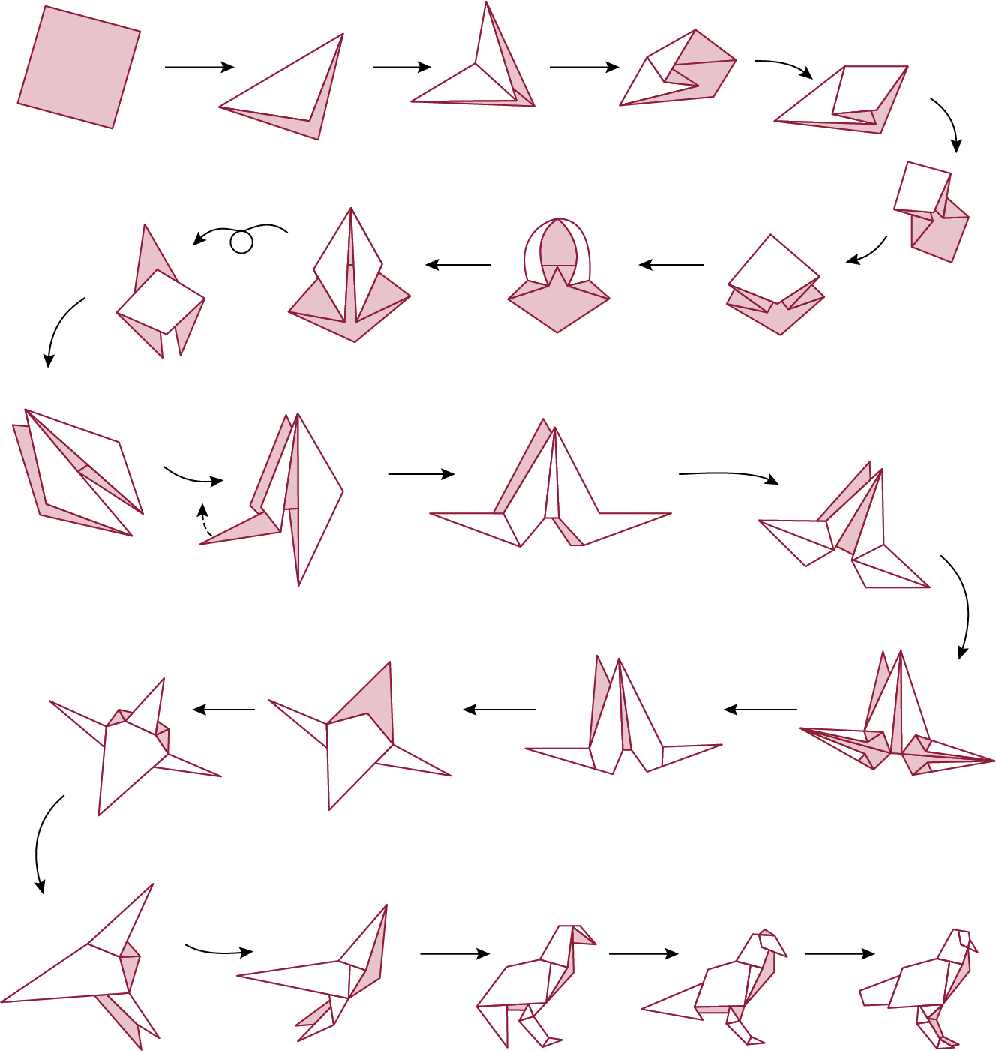
Figure 5.2 Folding a bird from a square piece of paper

Slide 9
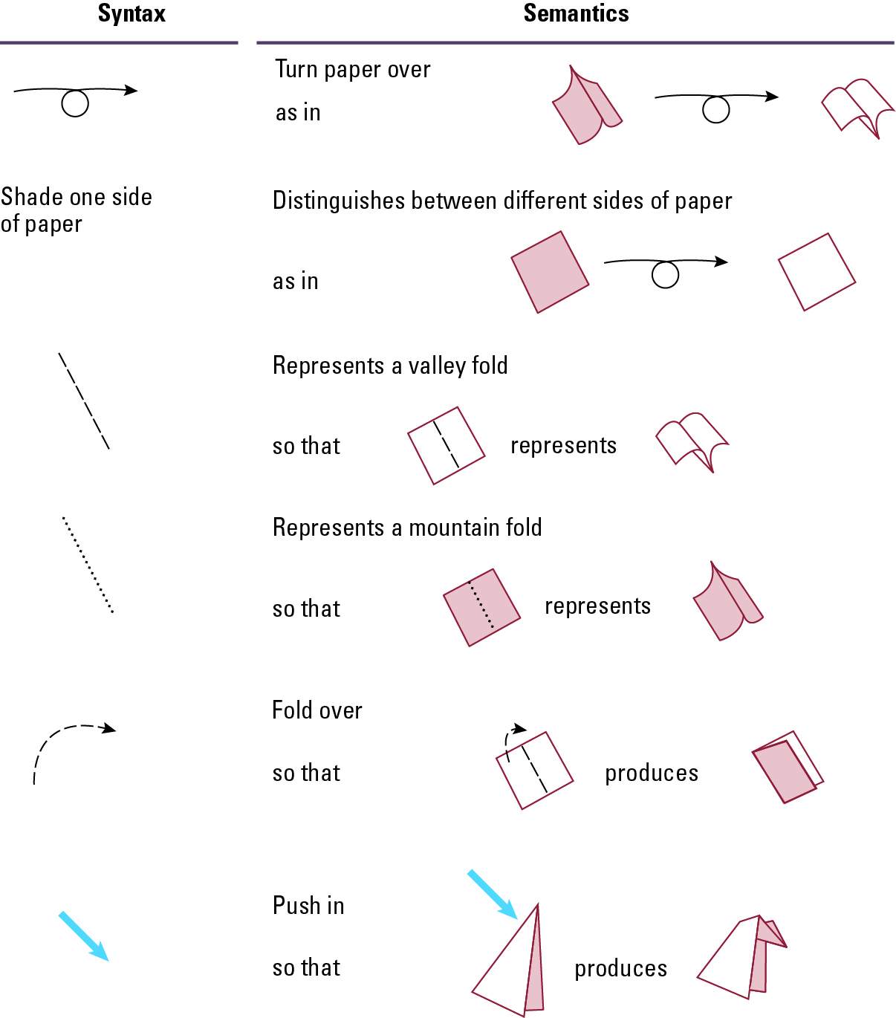
Figure 5.3 Origami primitives

Slide 10
Designing a Pseudocode Language
Choose a common programming language
Loosen some of the syntax(規範的) rules
Allow for some natural language
Use consistent, concise notation
We will use a Python-like Pseudocode

Slide 11
Pseudocode Primitives
Assignment
name = expression
example
RemainingFunds = CheckingBalance +
SavingsBalance

Slide 12
Pseudocode Primitives (continued)
Conditional selection
if (condition):
activity
example
if (sales have decreased):
lower the price by 5%

Slide 13
Pseudocode Primitives (continued)
Conditional selection
if (condition):
activity
else:
activity
example
if (year is leap year):
daily total = total / 366
else:
daily total = total / 365

Slide 14
Pseudocode Primitives (continued)
Repeated execution
while (condition):
body
example
while (tickets remain to be sold):
sell a ticket

Slide 15
Pseudocode Primitives (continued)
Indentation shows nested(嵌套的) conditions
if (not raining):
if (temperature == hot):
go swimming
else:
play golf
else:
watch television

Slide 16
Pseudocode Primitives (continued)
Define a function
def name():
example
def ProcessLoan():
Executing a function
if (. . .):
ProcessLoan()
else:
RejectApplication()

Slide 17
Figure 5.4 The procedure Greetings in pseudocode
def Greetings():
Count = 3
while (Count > 0):
print('Hello')
Count = Count - 1

Slide 18
Pseudocode Primitives (continued)
Using parameters(參數)
def Sort(List):
.
.
Executing Sort on different lists
Sort(the membership list)
Sort(the wedding guest list)

Slide 19
5.3 Algorithm Discovery
The first step in developing a program
More of an art than a skill
A challenging task

Slide 20
Polya’s Problem Solving Steps
1. Understand the problem.
2. Devise a plan for solving the problem.
3. Carry out the plan.
4. Evaluate the solution for accuracy and its potential as a tool for solving other problems.

Slide 21
Polya’s Steps in the Context of Program Development
1. Understand the problem.
2. Get an idea of how an algorithmic function might solve the problem.
3. Formulate(構思) the algorithm and represent it as a program.
4. Evaluate the solution for accuracy and its potential as a tool for solving other problems.

Slide 22
Getting a Foot in the Door
Try working the problem backwards
Solve an easier related problem
  Relax some of the problem constraints
  Solve pieces of the problem first (bottom up methodology)
Stepwise refinement: Divide the problem into smaller problems (top-down methodology)

Slide 23
Ages of Children Problem
Person A is charged with the task of determining the ages of B’s three children.
  B tells A that the product of the children’s ages is 36.
  A replies that another clue is required.
  B tells A the sum of the children’s ages.
  A replies that another clue is needed.
  B tells A that the oldest child plays the piano.
  A tells B the ages of the three children.
How old are the three children?

Slide 24
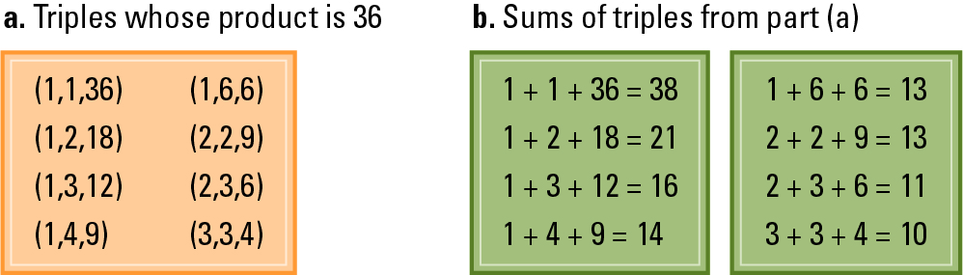
Figure 5.5

Slide 25
5.4 Iterative Structures(迭代結構)
A collection of instructions repeated in a looping manner
Examples include:
  Sequential Search Algorithm
  Insertion Sort Algorithm

Slide 26
Figure 5.6 The sequential search algorithm in pseudocode
def Search (List, TargetValue):
if (List is empty):
Declare search a failure
else:
Select the first entry in List to be TestEntry
while (TargetValue > TestEntry and entries remain):
Select the next entry in List as TestEntry
if (TargetValue == TestEntry):
Declare search a success
else:
Declare search a failure

Slide 27
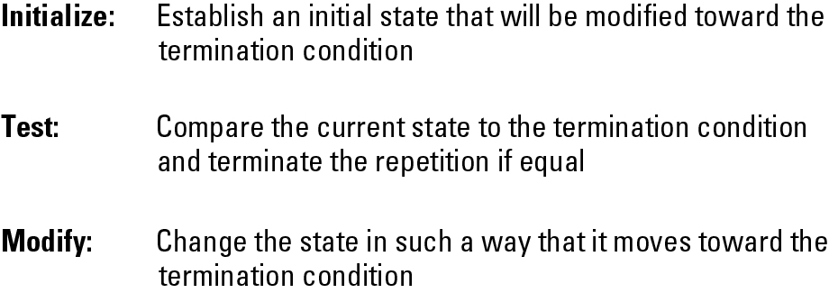
Figure 5.7 Components of repetitive control

Slide 28
Iterative Structures
Pretest loop:
while (condition):
body
Posttest loop:
repeat:
body
until(condition)

Slide 29
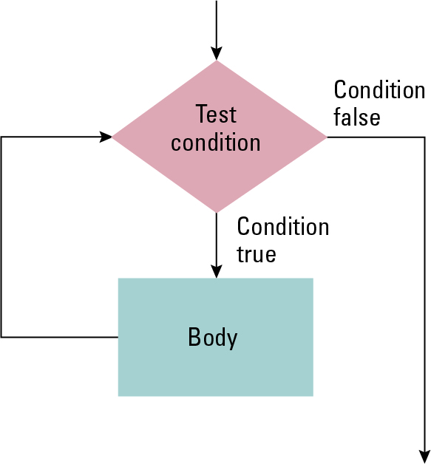
Figure 5.8 The while loop structure

Slide 30
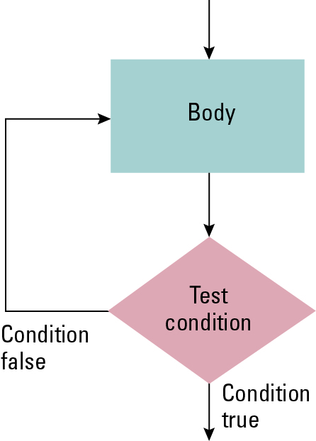
Figure 5.9 The repeat loop structure

Slide 31
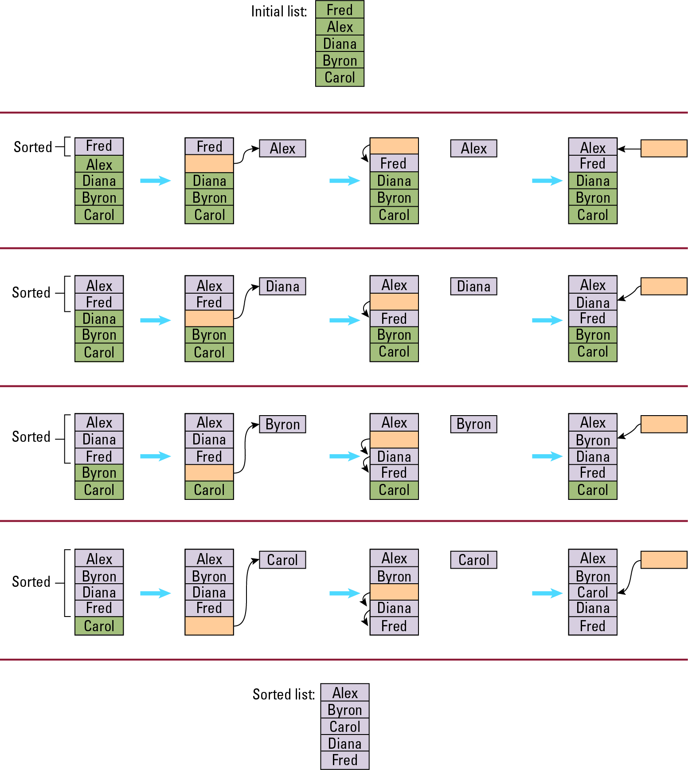
Figure 5.10 Sorting the list Fred, Alex, Diana, Byron, and Carol alphabetically

Slide 32
Figure 5.11 The insertion sort algorithm expressed in pseudocode
def Sort(List):
N = 2
while (N <= length of List):
Pivot = Nth entry in List
Remove Nth entry leaving a hole in List
while (there is an Entry above the
hole and Entry > Pivot):
Move Entry down into the hole leaving
a hole in the list above the Entry
Move Pivot into the hole
N = N + 1

Slide 33
5.5 Recursive Structures
Repeating the set of instructions as a subtask of itself.
Multiple activations of the procedure are formed, all but one of which are waiting for other activations to complete.
Example: The Binary Search Algorithm

Slide 34
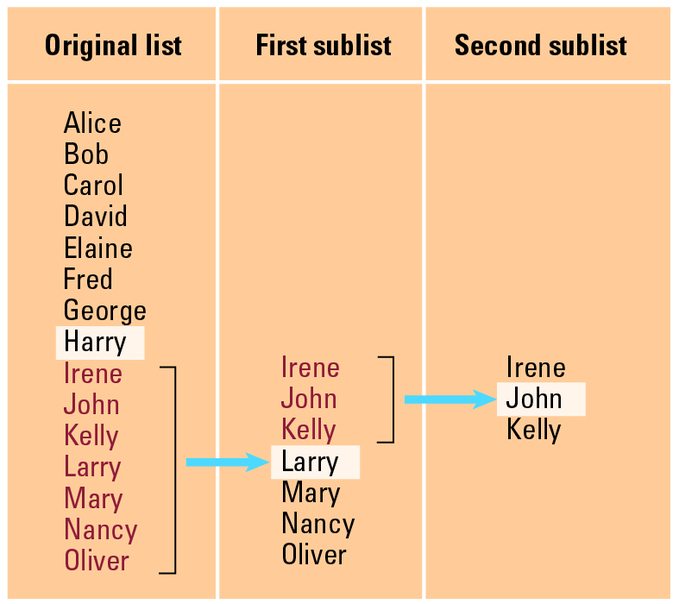
Figure 5.12 Applying our strategy to search a list for the entry John

Slide 35
Figure 5.13 A first draft of the binary search technique
if (List is empty):
Report that the search failed
else:
TestEntry = middle entry in the List
if (TargetValue == TestEntry):
Report that the search succeeded
if (TargetValue < TestEntry):
Search the portion of List preceding TestEntry for
TargetValue, and report the result of that search
if (TargetValue > TestEntry):
Search the portion of List following TestEntry for
TargetValue, and report the result of that search

Slide 36
Figure 5.14 The binary search algorithm in pseudocode
def Search(List, TargetValue):
if (List is empty):
Report that the search failed
else:
TestEntry = middle entry in the List
if (TargetValue == TestEntry):
Report that the search succeeded
if (TargetValue < TestEntry):
Sublist = portion of List preceding TestEntry
Search(Sublist, TargetValue)
if (TargetValue < TestEntry):
Sublist = portion of List following TestEntry
Search(Sublist, TargetValue)

Slide 37
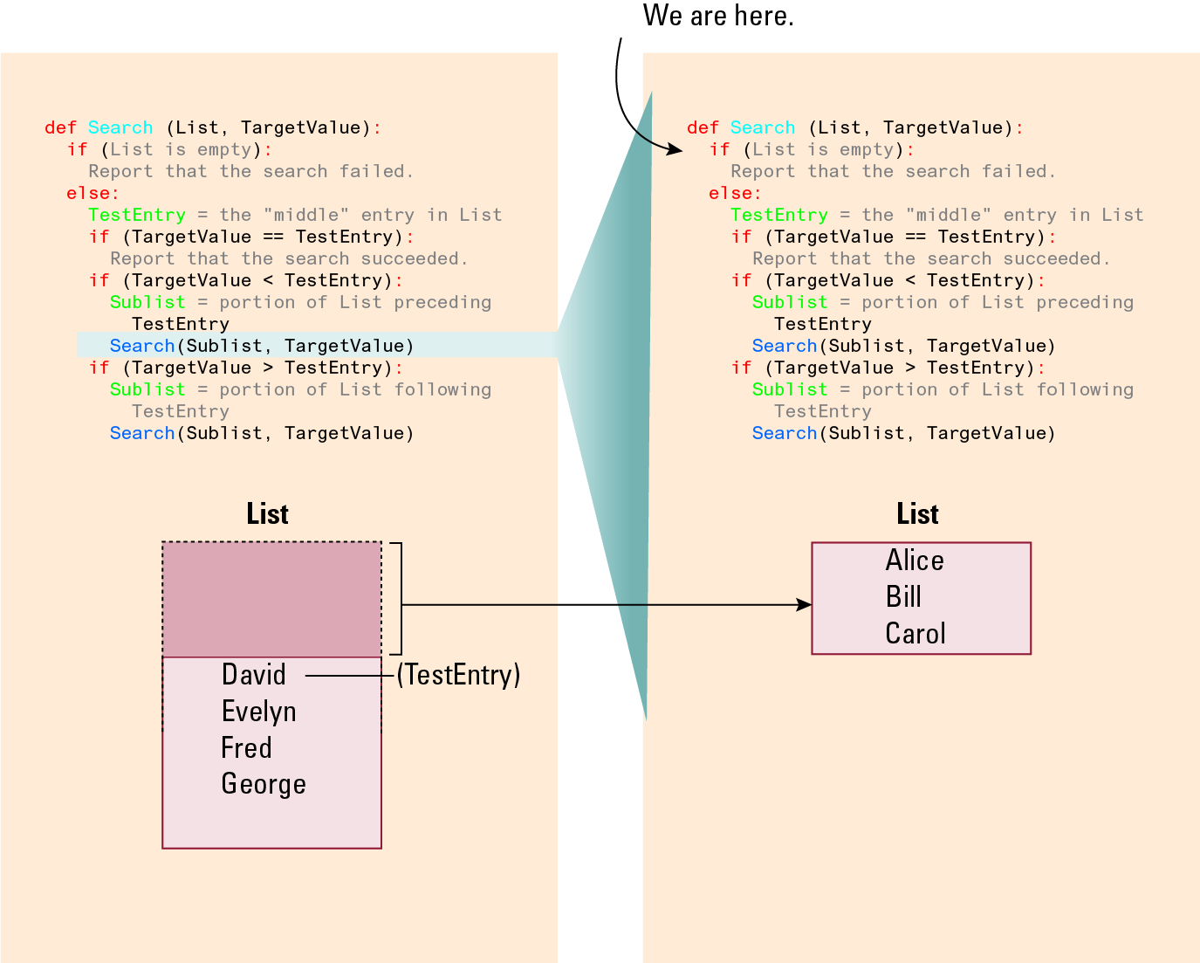
Figure 5.15 Recursively Searching

Slide 38

Figure 5.16 Second Recursive Search

Slide 39
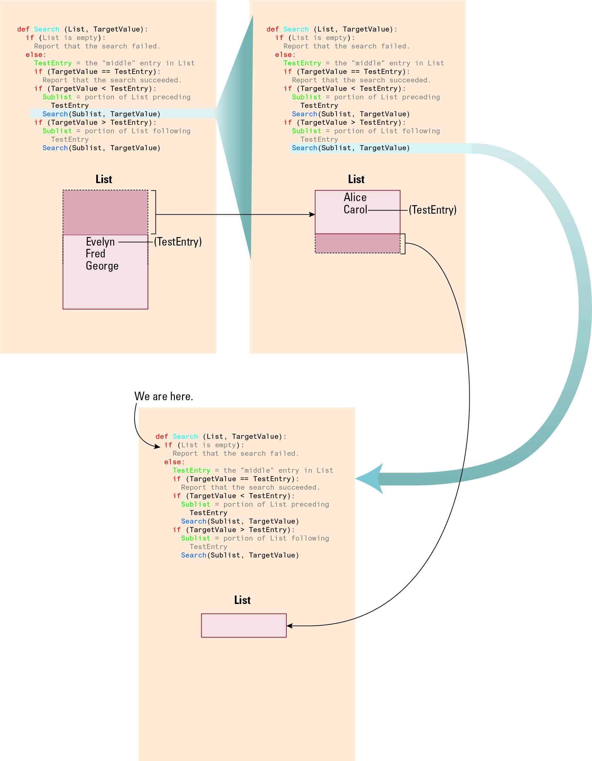
Figure 5.17 Second Recursive Search, Second Snapshot

Slide 40
Recursive Control
Requires initialization, modification, and a test for termination (base case)
Provides the illusion of multiple copies of the function, created dynamically in a telescoping manner
Only one copy is actually running at a given time, the others are waiting
11/24

Slide 41
5.6 Efficiency and Correctness
The choice between efficient and inefficient algorithms can make the difference between a practical solution and an impractical one
The correctness of an algorithm is determined by reasoning formally about the algorithm, not by testing its implementation

Slide 42
Efficiency
Measured as number of instructions executed
Uses big theta notation:
  Example: Insertion sort is in Θ(n²)
Incorporates best, worst, and average case analysis

Slide 43
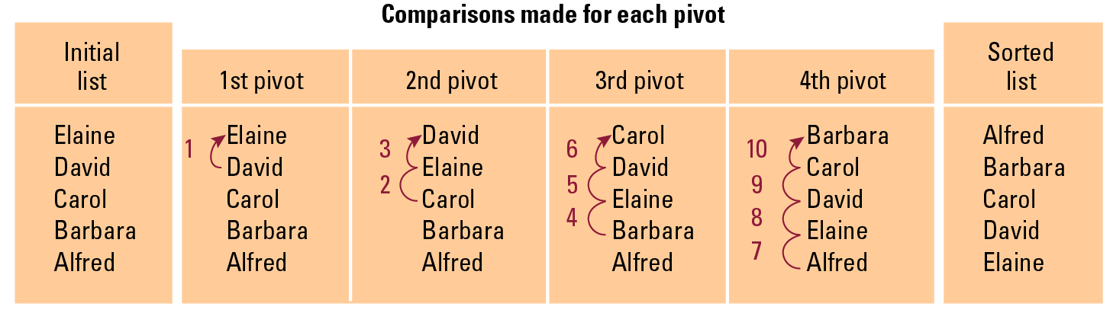
Figure 5.18 Applying the insertion sort in a worst-case situation

Slide 44
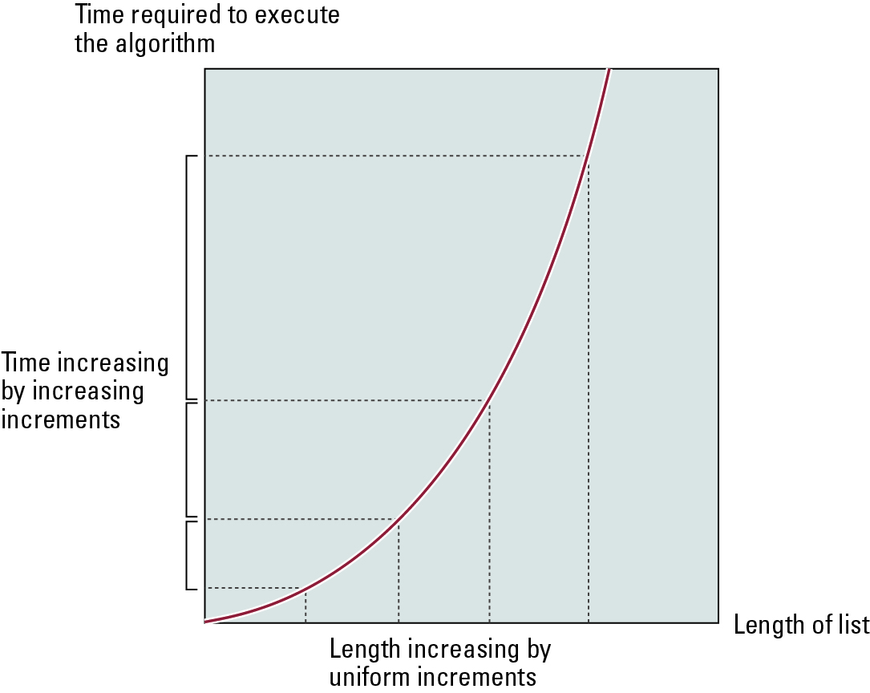
Figure 5.19 Graph of the worst-case analysis of the insertion sort algorithm

Slide 45
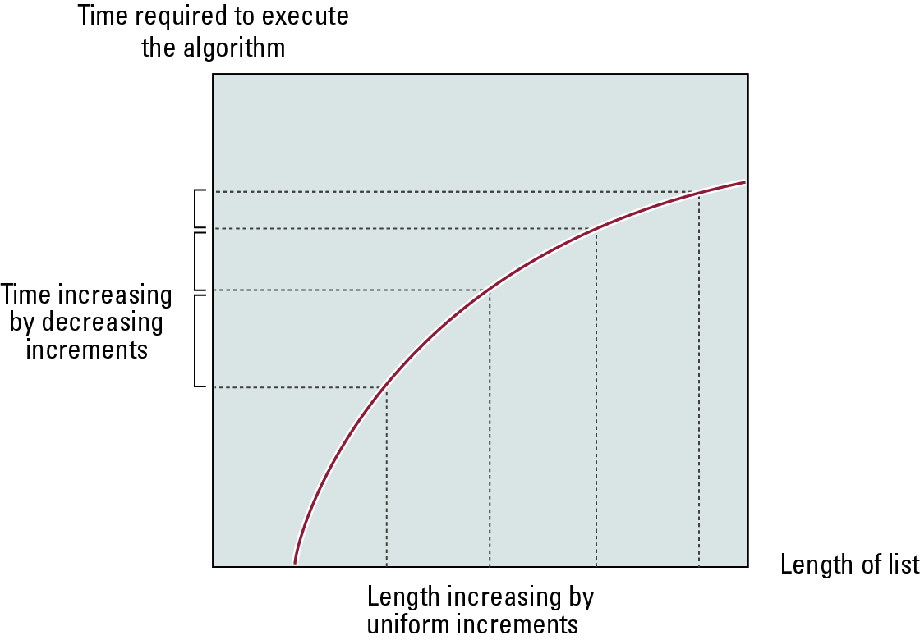
Figure 5.20 Graph of the worst-case analysis of the binary search algorithm

Slide 46
Software Verification
Proof of correctness (with formal logic)
  Assertions
    Preconditions
    Loop invariants
Testing is more commonly used to verify software
Testing only proves that the program is correct for the test cases used

Slide 47
Chain Separating Problem
A traveler has a gold chain of seven links.
He must stay at an isolated hotel for seven nights.
The rent each night consists of one link from the chain.
What is the fewest number of links that must be cut so that the traveler can pay the hotel one link of the chain each morning without paying for lodging in advance?

Slide 48
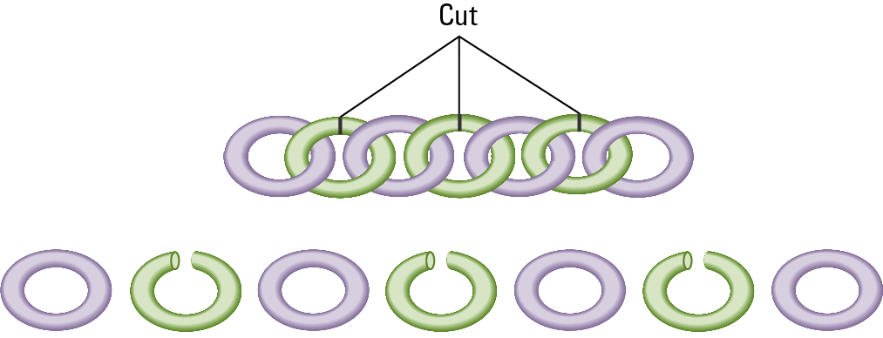
Figure 5.21 Separating the chain using only three cuts

Slide 49
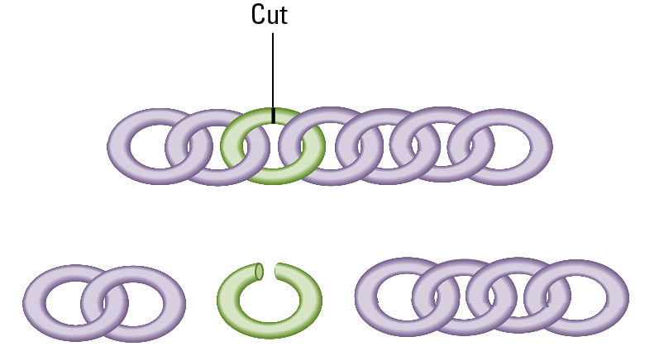
Figure 5.22 Solving the problem with only one cut

Slide 50
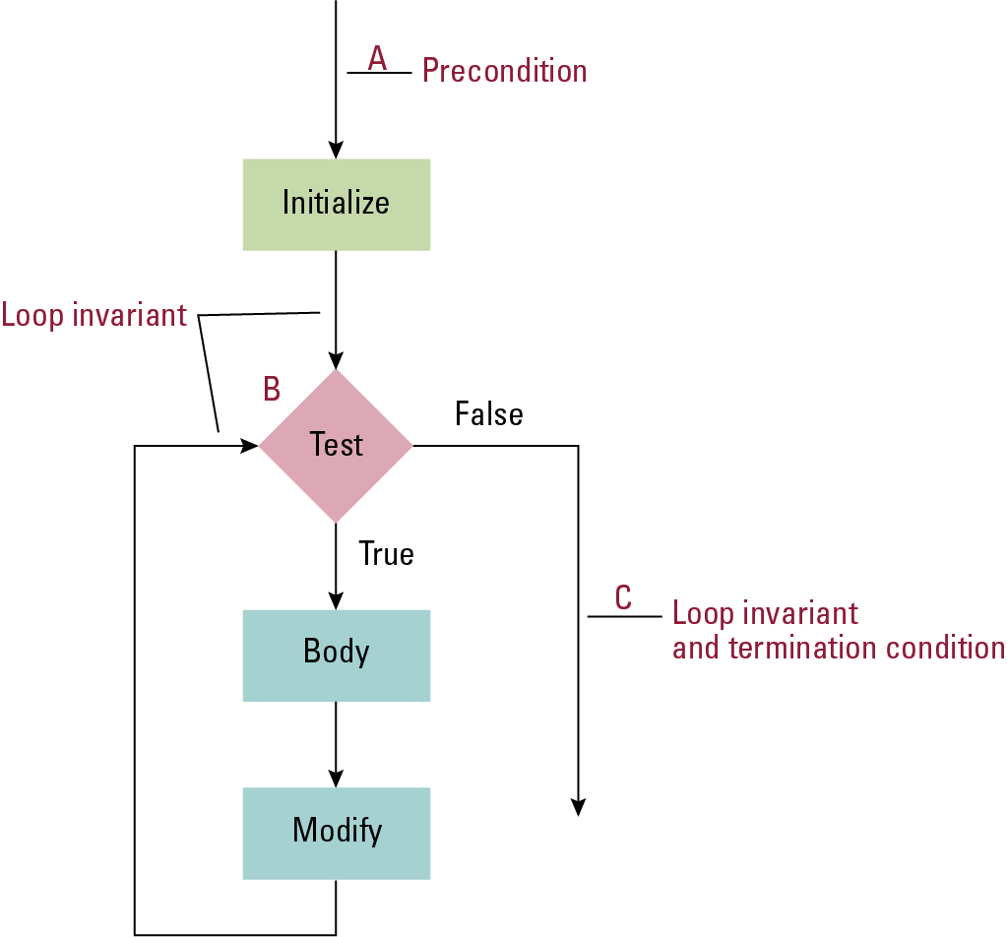
Figure 5.23 The assertions associated with a typical while structure

